Slide 1
Day 3 – Attention, Transformers, NLP

Slide 2
Attention
A closer approximation to human perception
Allows for non-linear correlation between input elements to be discovered
Forces elements to “compete” to have attention paid to them

Slide 3
Some Model
2x1 output predictions
4x5 input

Slide 4
With MLPs
Flatten
Usual MLP stuff
Final Linear Layer
2x1 output predictions
4x5 input
20x1 hidden vectors
More hidden representations

Slide 5
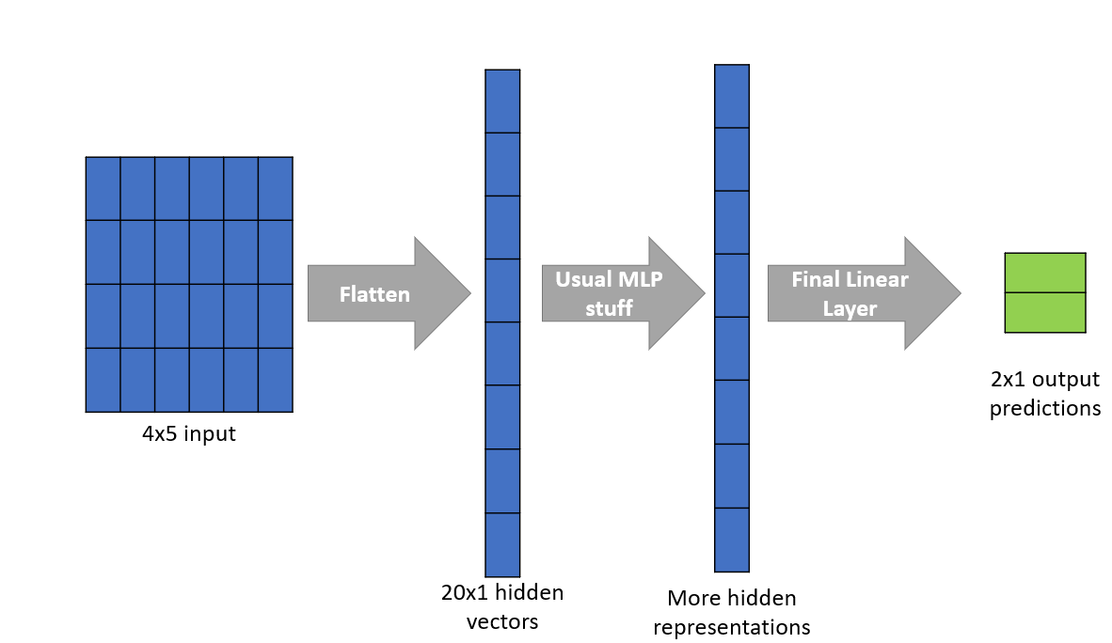
With MLPs
Notice a few problems with this approach:
All elements are treated equally
Your input may be a sequence of 4 vectors with dimensionality of 5 but the model just treats it as 1 single vector of 20
Positional information is lost
The model loses any information about the position of where each element is relative to the other elements
Linear relations within each layer
By design of the MLP layer, only linear (or rather trivial polynomial) relations can be discovered between elements.
Complex relations require additional layers

Slide 6
With Attention
Step 1
Keys
Step 2
Final Linear Layer
2x1 output predictions
4x5 input
Queries
Values
New hidden representation

Slide 7
Attention – Step 1
Treat the 4x5 data as a sequence of 4 vectors with dimensionality of 5
Do the following for each of the 4 vectors:
Use an MLP to generate a key
Use another MLP to generate a query
Use another MLP to generate a value
Key and query must have same dimensionality
In short: Use 3 separate linear layers (MLPs) to generate 3 distinct outputs of same shape for each vector

Slide 8
Attention – Step 1
1
2
3
Element 1
Key 1
2
4
5
Key Network
Element 2
Key 2

Slide 9
Attention – Step 1
1
2
3
0
1
2
Element 1
Key 1
Query 1
2
4
5
0
1
2
Query Network
Element 2
Key 2
Query 2

Slide 10
Attention – Step 1
1
2
3
0
1
2
1
1
1
Element 1
Key 1
Query 1
Value 1
3
-1
1
2
4
5
2
2
2
Value Network
Element 2
Key 2
Value 2
Query 2

Slide 11
Attention – Step 2
Do the following for each of the elements
Find the dot product of that element’s key with every other element’s query
This creates some scalar value we can use
We shall call them the attention weights

Slide 12
Attention – Step 2
0
1
2
1
2
3
1
2
3
0
1
2
1
2
3
0
1
2
1
1
1
8
7
Element 1
Attention weights
Key 1
Query 1
Value 1
3
-1
1
2
4
5
3
-1
1
3
-1
1
2
4
5
2
4
5
2
2
2
14
7
Element 2
Attention weights
Key 2
Query 2
Value 2

Slide 13
Attention – Step 3
Do the following for each of the elements
Find the dot product of that element’s key with every other element’s query
This creates some scalar value we can use
We shall call them the attention weights
Softmax the scalar values so they all sum to 1
Multiply the softmaxed scalars to the value vector of each element then sum all these up
This becomes the new representation for that particular element

Slide 14
Attention – Step 3
1
2
-1
0.73*1 + 0.27*2
0.73*2 + 0.27*1
0.73*-1 + 0.27*1
8
7
0.73
0.27
Attention weights
Softmax-ed Attention weights
Element 1
Value 1
1
2
3
0
1
2
Softmax
Key 1
Query 1
0.99*1 + 0.01*2
0.99*2 + 0.01*1
0.99*-1 + 0.01*1
2
1
1
Element 2
14
7
0.99
0.01
2
4
5
3
-1
1
Softmax-ed Attention weights
Attention weights
Value 2
Key 2
Query 2

Slide 15
Attention vs MLP
By having a key, query, and value, you allow each element to decide the amount of information needs from the other elements
This is quite similar to weights in a normal MLP
However, since the scalar result of the dot product of key and query depends on the contents of the key as well as the query, this means weights can be assigned depending on the content of the key query pair
Unlike a normal MLP which always assigns the same weight to elements in a certain position

Slide 16
Attention vs MLP
MLP layers are like bus drivers
Regardless of what passengers they get, they travel the same route
It is somewhat rigid in what it does
Attention Layers are like grab drivers
Each passenger will travel a different route
Hence offers greater flexibility

Slide 17
Attention and Transformers
Transformers are the architecture that popularised the attention mechanism
Try reading Attention is All You Need
Almost all popular NLP models use some variant of the Transformer Architecture
Comprises of 2 main components
Encoders
Decoders

Slide 18
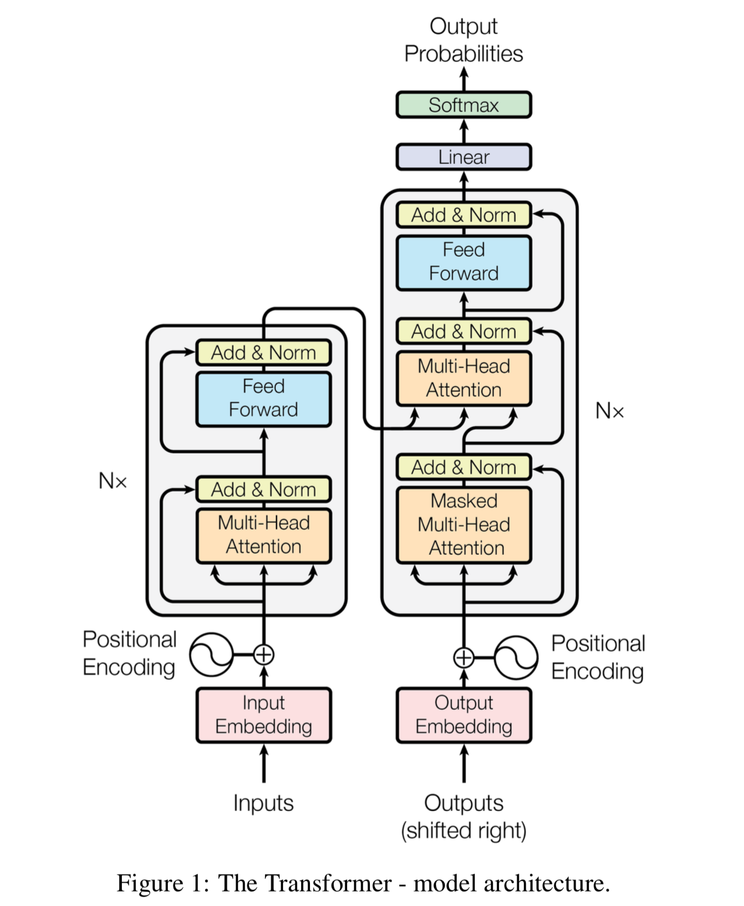
Attention and Transformers - Encoders
Encoders “encode” the input to create a useful representation of the input that can be used for further tasks
It tries to emphasize useful information while filtering our noise so that other parts of the model can use the information well

Slide 19
Attention and Transformers - Encoders
Multi-Head Attention
Fancy way of saying “use multiple attention layers in parallel”
Basically feed the same input to a bunch of attention layers and then combine their inputs
Allows for “cleaner” information processing
Each attention head can focus on one task
E.g: one head can learn about grammar, another can learn about semantics
Note that there is no easy way to determine what each head has learnt

Slide 20
Attention and Transformers - Decoders
Decoders “decode” the information received (can be from encoders or any other source
For sequential data, it uses attention to make use of what the model “knows” about the previous elements to predict the current output
So kinda like revision
From Encoder
Previous Outputs

Slide 21
Attention and Transformers - Decoders
Masked Attention and Masked Language Modelling (MLM) - not what you think
In this particular decoder, masking is applied to hide parts of the information received by the decoder
In most cases, decoders are pre-trained by hiding parts of the information provided and requiring it to predict the hidden part
In the NLP context, this forces the model to learn a general understanding of the language structure
From Encoder
Previous Outputs

Slide 22

Attention and Transformers – BERT case study
The Model that popularised Transformers
Like seriously, just go to paperswithcode and see how many people name their NLP models after BERT
Presented 3 primary ideas that revolutionised NLP
Attention – Specifically the viability of the transformer architecture (just the encoder)
Masked Language Modelling – Turns out MLM gives more than financial freedom, but also improves model performance on downstream tasks
Subword Tokenization – Breaking down words into fundamental chunks

Slide 23
Attention and Transformers – BERT case study
Subword Tokenization
By breaking down words into subwords, models can learn to interpret/handle words it has not seen before
Traditionally, NLP engineers would just add a “idk” token and hope for the best
It becomes easier to handle abbreviations as well (should’ve, won’t)
Interestingly, it also means slangs and weird typing habits can be handled by the model
Like u kno how sum peepo typ liddis?
Previously such words would have had to be manually removed or changed

Slide 24
Attention and Transformers – BERT case study
Subword Tokenization
There are a few more popular subword tokenization algorithms that have popped up
Byte Pair Encoding (BPE) – Seriously old, wasn’t even meant for NLP but works well.
WordPiece – “The BERT one”. Basically BPE but specialised for English language. Is also trainable
SentencePiece – Modernised version of WordPiece, from ALBERT. Sometimes works better than WordPiece, depends on context
There are many others, but the goal is the same: To break down individual words to improve signal to noise ratio

Slide 25

THE END

